Slide 1

Zscaler Zero Trust Cloud Security Virtual Internship
by
Sree Nithya G
Roll No. 204G1A32A1
Department of Computer Science and Engineering (Data Science)
Srinivasa Ramanujan Institute of Technology
(Affiliated to JNTUA & Approved by AICTE) (Accredited by NAAC with ‘A’ Grade & Accredited by NBA (EEE, ECE & CSE)
Rotarypuram Village, B K Samudram Mandal, Ananthapuramu – 515701.
2023 - 2024

Slide 2

Contents
Course Objective
Introduction
Technology
Applications
Modules
Real Time applications
Learning outcomes
GitHub Link
Queries

Slide 3
Course Objective
Gain a comprehensive understanding of Zero Trust security architecture and its importance in modern cybersecurity
Learn how to implement identify verification, access control, and policy enforcement in Zero Trust framework
Engage in practical exercises and labs to apply Zero Trust principles in real-world scenarios
Identify and Mitigate potential security risks using Zero Trust strategies
Develop and enforce security policies that align with Zero Trust principles

Slide 4
Introduction
Recognize the importance of shifting from a legacy network and security architecture to a Zero Trust architecture in a new world of digital transformation
Identify the background and importance of the three sections needed to build a successful Zero Trust architecture
Discover how connections are made to and from Zscaler's Zero Trust Exchange
Determine the technology and architectural considerations needed when building a true Zero Trust architecture
Explain how Zscaler's Zero Trust Exchange accomplishes each of all the elements of a true Zero Trust architecture

Slide 5
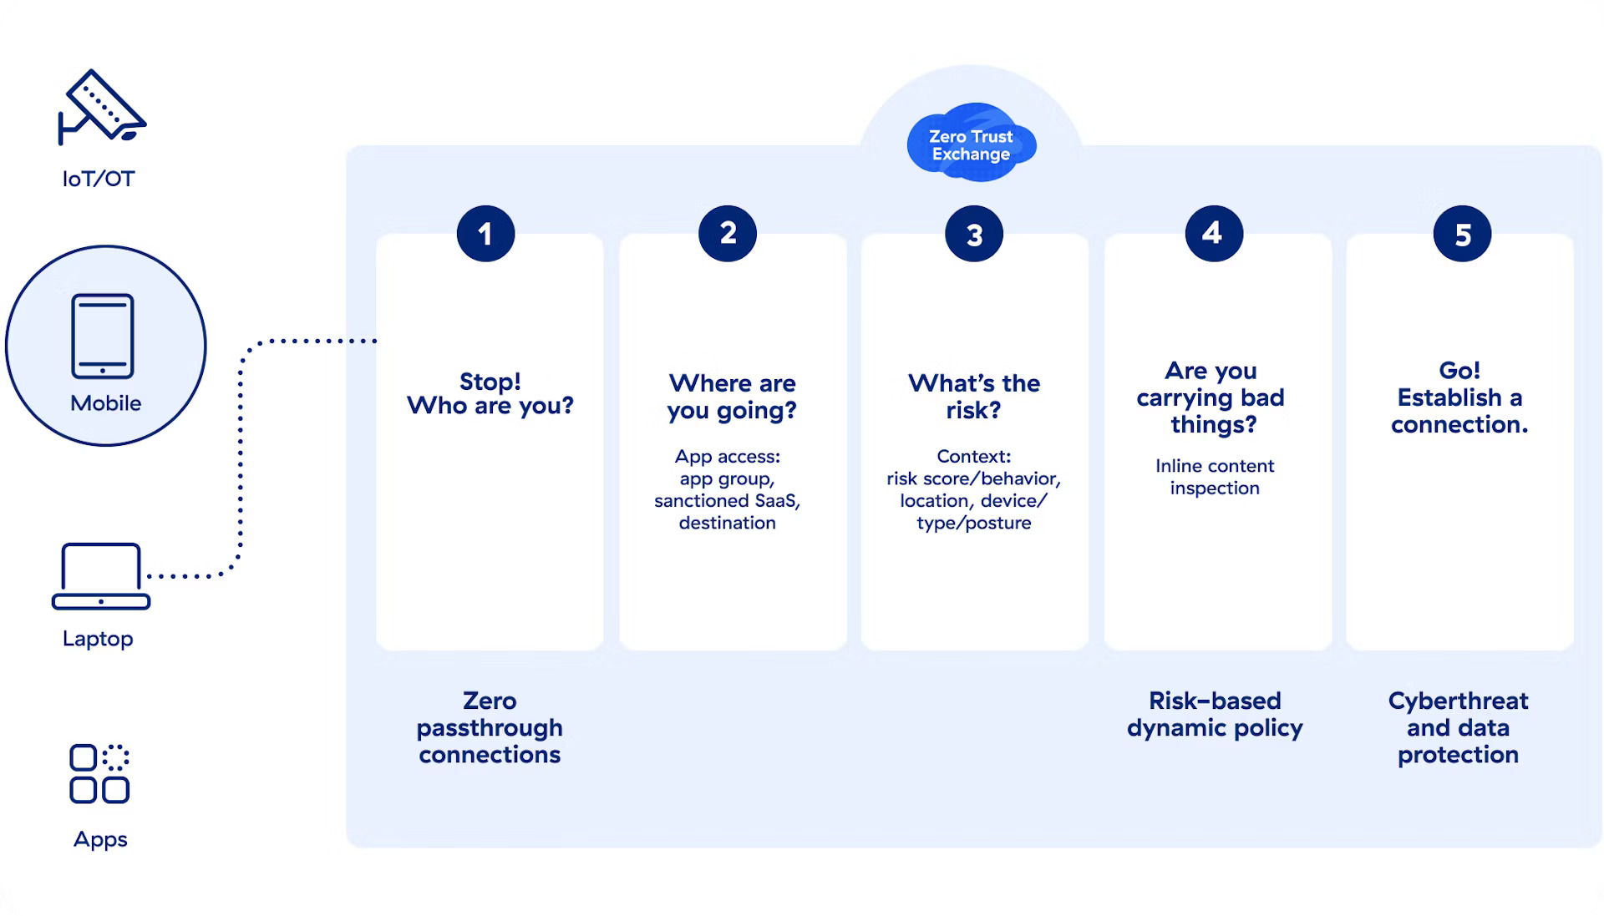
Working of Zero Trust Cloud Security

Slide 6
Technology
Zscaler Private Access (ZPA): A VPN alternative that provides secure access to internal applications and services. ZPA features include policy-driven connectivity, application-specific connectivity, and ease of deployment.
Zscaler Client Connector (ZCC): An application that secures internet traffic and access to internal apps. It can automatically recognize when you're connected to a trusted network or Wi-Fi hotspot.
Zscaler Internet Access (ZIA): A cloud-native security service edge (SSE) solution that provides zero trust access to the internet and SaaS apps. ZIA features include cyberthreat and ransomware protection, data protection, and lower cost and complexity

Slide 7
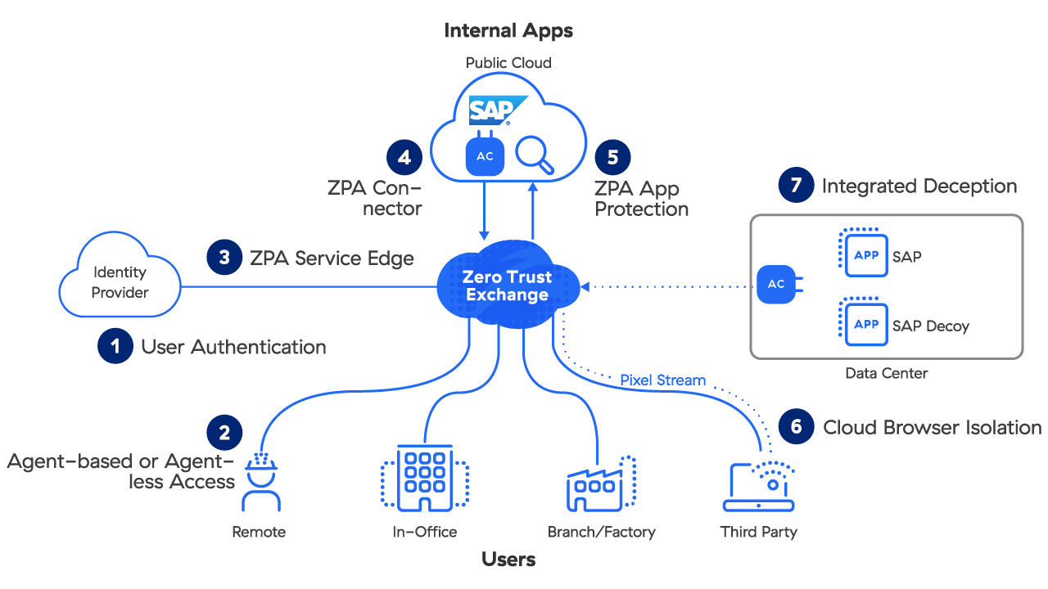
Zscaler Private Access (ZPA)

Slide 8
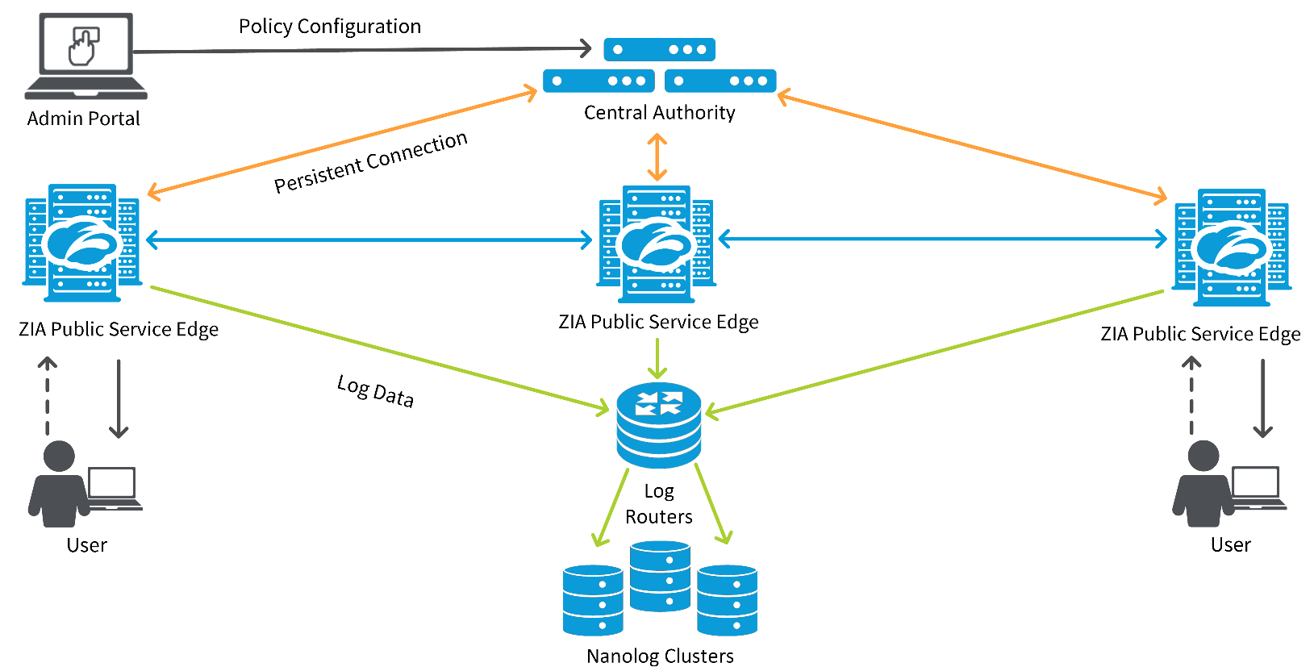
Zscaler Internet Access (ZIA)

Slide 9
Applications
Corporate Networks: Implementing Zero Trust in enterprise networks to secure internal and external communications.
Remote Work: Ensuring secure access for remote workers using Zscalar’s solutions.
BYOD (Bring Your Own Device): Securing personal devices accessing corporate resources.
Third-Party Access: Managing and securing access for third-party vendors and contractors.
Cloud Services: Securing access to cloud applications and services using Zero Trust principles.

Slide 10
Modules
Verify Identity and Context
Control Content & Access
Enforce Policy

Slide 11
Verify Identity and Context
Multi-Factor Authentication (MFA): Implementing MFA to enhance user verification processes.
Identity Management: Centralized management of user identities and roles.
Behavioral Analytics: Using analytics to monitor and verify user behavior.
Context-Aware Access: Making access decisions based on the context, such as location and device health.
Continuous Monitoring: Continuously monitoring identity and access to detect anomalies in real-time.

Slide 12
Control Content and Access
Access Control Policies: Defining and enforcing granular access control policies.
Data Encryption: Encrypting data in transit and at rest to protect sensitive information.
Content Inspection: Inspecting content for threats and compliance violations.
Application Segmentation: Segmenting applications to reduce the attack surface.
Zero Trust Network Access (ZTNA): Implementing ZTNA to control and secure access to applications.

Slide 13
Enhance Policy
Policy Definition: Creating clear and comprehensive security policies.
Automated Policy Enforcement: Using automation to enforce security policies consistently.
Compliance Monitoring: Ensuring compliance with regulatory requirements through continuous monitoring.
Incident Response: Establishing procedures for responding to security incidents.
Auditing and Reporting: Regularly auditing security policies and generating reports for stakeholders.

Slide 14
Real Time Applications
Securing Remote Workforces: Applying Zero Trust to ensure secure remote access.
Protecting Sensitive Data: Using Zero Trust to safeguard sensitive data in real-time.
Dynamic Threat Response: Real-time detection and response to threats using Zero Trust.
Regulatory Compliance: Ensuring real-time compliance with industry regulations.
Enhanced User Experience: Providing a secure yet seamless user experience with real-time policy enforcement.

Slide 15
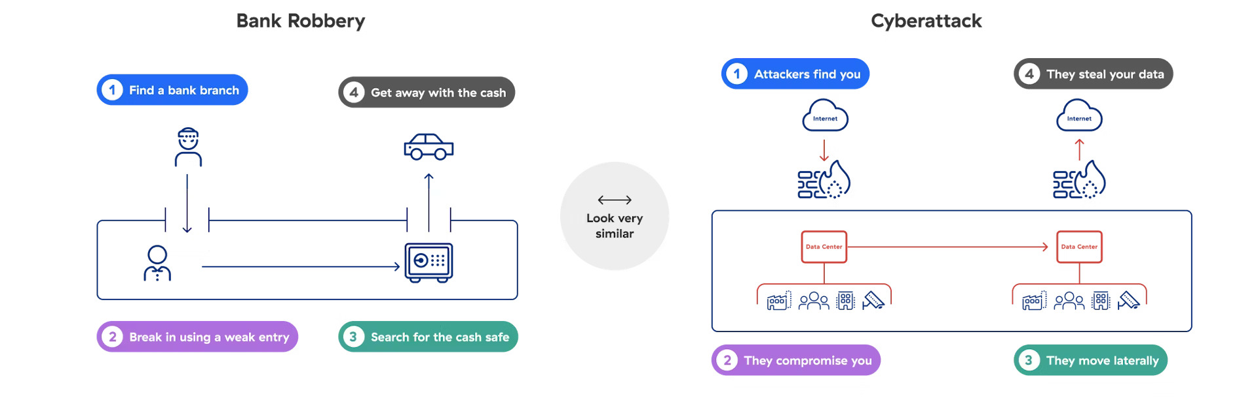
Cyberattack Visualization

Slide 16
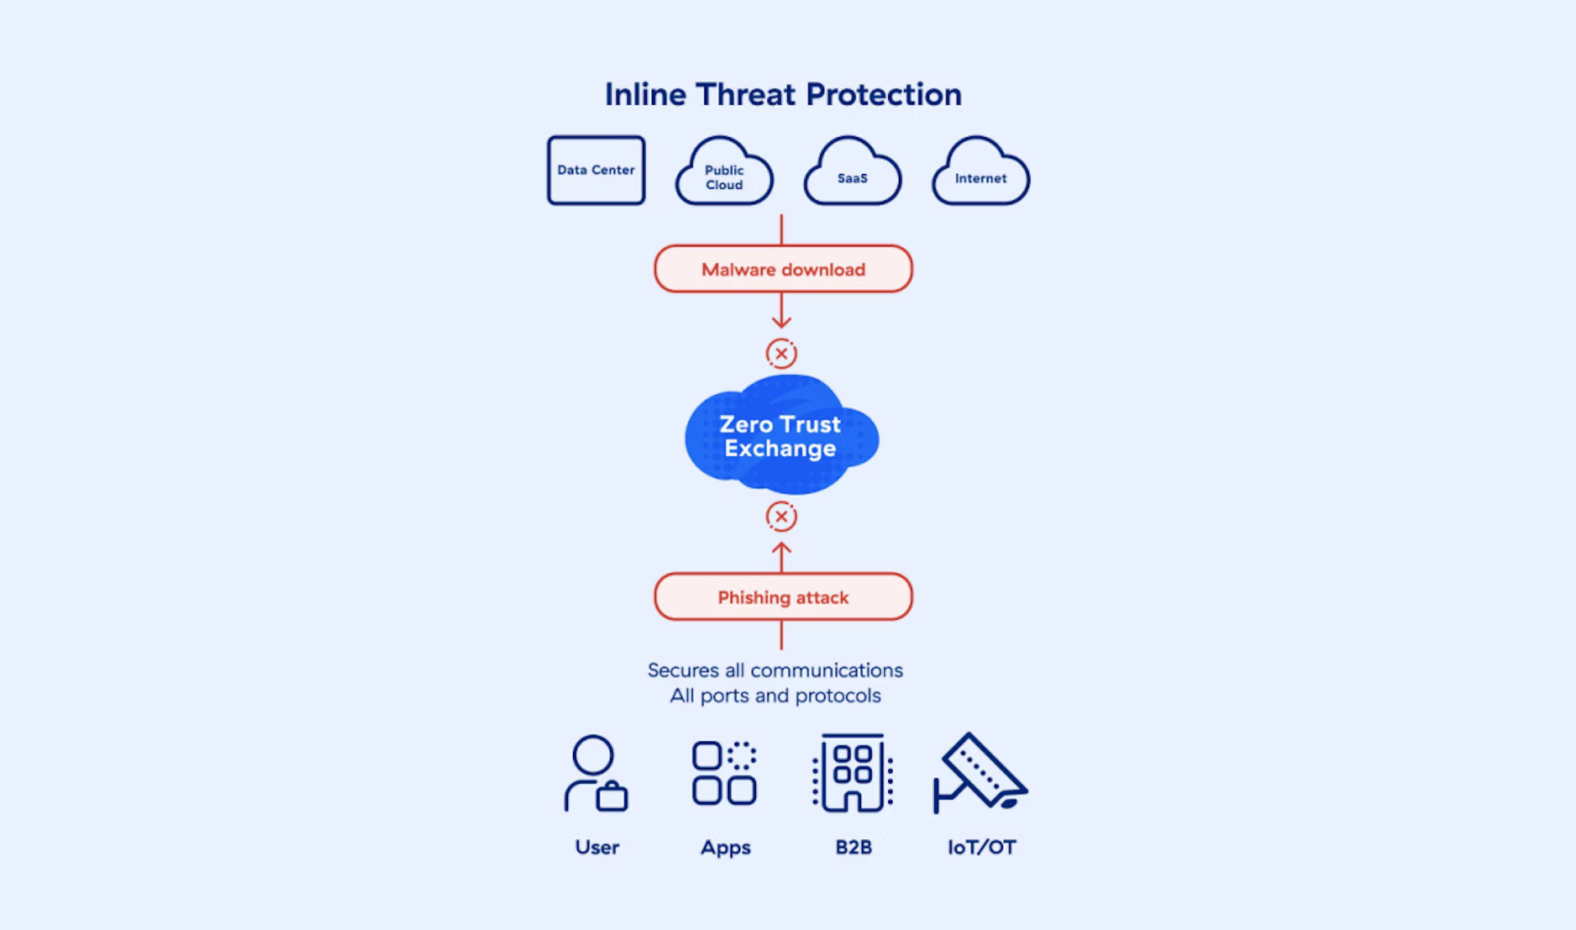
Threat Protection

Slide 17
Learning Outcomes
Zero Trust Implementation: Ability to implement Zero Trust principles in various IT environments.
Proficiency with Zscalar Tools: Skilled use of Zscalar tools for security management.
Security Policy Development: Competence in developing and enforcing robust security policies.
Threat Detection and Response: Enhanced ability to detect and respond to security threats.
Compliance Management: Improved skills in managing compliance and regulatory requirements.

Slide 18
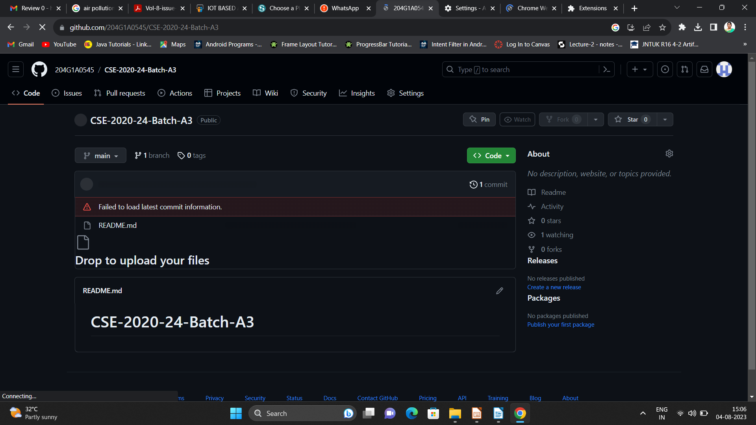

Git Hub Dashboard
Repository Name Like: Summer Internship - II
Under that include document, presentation and Certificate(Pdf).

Slide 19
Any Queries?

Slide 20
Thank You!!!

